Slide 1

Network Security Assessment
By James Driscoll

Slide 2
Malware Threats and Vulnerabilities Analysis
Definition – Investigating the behavior and purpose of a suspicious file or URL. The results of investigation helps prevent and mitigate potential threats.

Slide 3
Malware Threats and Vulnerabilities Analysis Benefits
Segregate incidents by level of severity
Find and block hidden Indicators of compromise (IOC)
Enhance success rate of IOC alerts and notifications
Enhance conditions when threat hunting

Slide 4
Types of Malware Threats and Vulnerabilities Analysis
Static Analysis
Looks for signs of malicious intent in a file.
Can also be used to find malicious infrastructure, libraries or packed files.
Dynamic Analysis
Runs suspected malicious code in a safe environment.
Allows for more through investigation.

Slide 5
Security Assessment Plan
Introduction
Used to assess, identify, and ensure implementation of security controls within a network.
Primary focus is to harden networks by finding vulnerabilities and patching them.

Slide 6
Security Assessment Plan
Scope
Assess the security protocols in place with the Cloud Service Provider (CSP)
Goals
Establish a documented baseline of the security protocols

Slide 7
Security Assessment Plan
Boundaries
Everything is vulnerable except:
User passwords will not be changed
Files will not be modified
Employee emails and browsing history will not be read
No Denial-of-Service (DoS) attacks
New weaknesses will not be entered into network
No intentional upload of malware

Slide 8
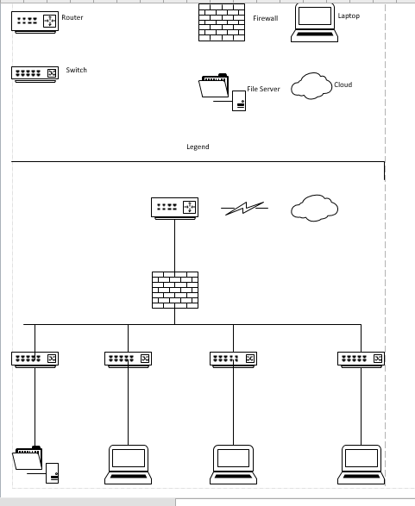
Network Upgrade

Slide 9
Cost Data
Type of Equipment | Initial Cost | Ongoing Cost | Replacement Cost
ADTRAN NetVanta 3140 Rm – router – rack-mountable – with Enhanced Feature P – With 5 year warranty | 651.99 | License for 300 calls $800 | 651.99
3 D-Link DGS 1250-52X-6KV – switch – 52 ports – smart – rack mountable | 1880.97 |  | 1880.97
HPE ProLiant DL360 Gen10 SMB Network Choice – rack mountable server + extended service warranty | 3050.98 |  | 1923.99
Watchguard Firebox T20-W-Security Appliance – with 1 year standard support | 478.99 | WatchGuard Total Security Suite 1 Year License $540 / 3 year $1,295 | 478.99

Slide 10
References
Advanced Network Security (n.d.). Retrieved from Watchguard: https://securityshop.watchguard.com/#/
Baker, K. (2020, March 26). Malware Analysis. Retrieved from Crowdstrike: https://www.crowdstrike.com/cybersecurity-101/malware/malware-analysis/
CDW - https://www.cdw.com/
(n.d.). FedRAMP Security Assessment Plan (SAP) Template
Routers – Jenne Inc http://marketing.jenne.com/Mailblast/ADT-J0068/AD10314B_Routers_QRG_WEB.pdf
Security Risk Assessment. (n.d.). Retrieved from Synopsys: https://www.synopsys.com/glossary/what-is-security-risk-assessment.html

